Slide 1
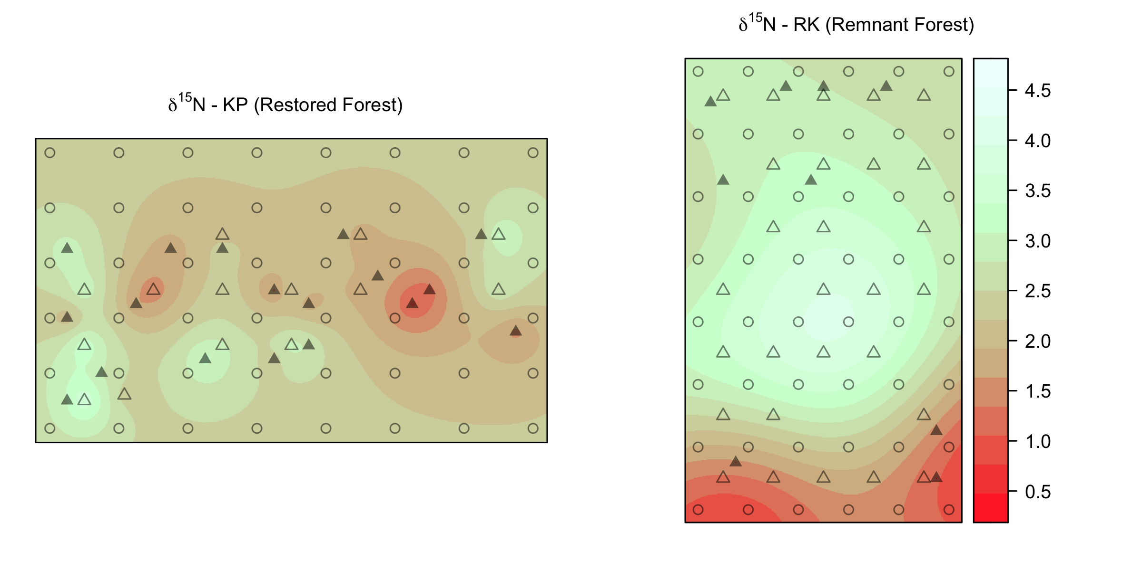
A
Foliar δ¹⁵N
Koa Plantation (KP)
B
δ¹⁵N ‰
5 m
N
Remnant Forest (RK)
Acacia koa
Rubus spp.
soil

